Slide 1





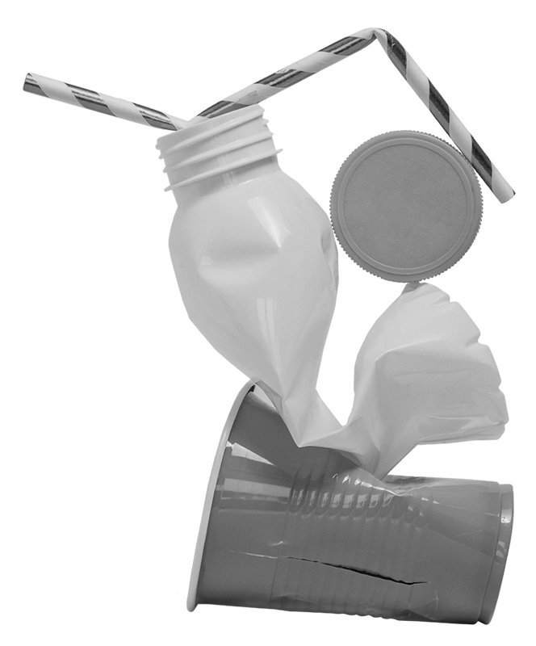
Team MLHeist
presents
CleanSweep.AI
A-EYE on SCATTERED GARBAGE SCRAP

Slide 2
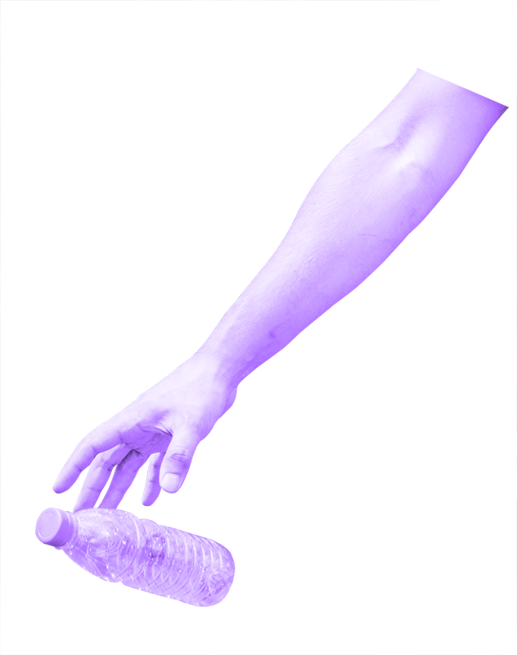
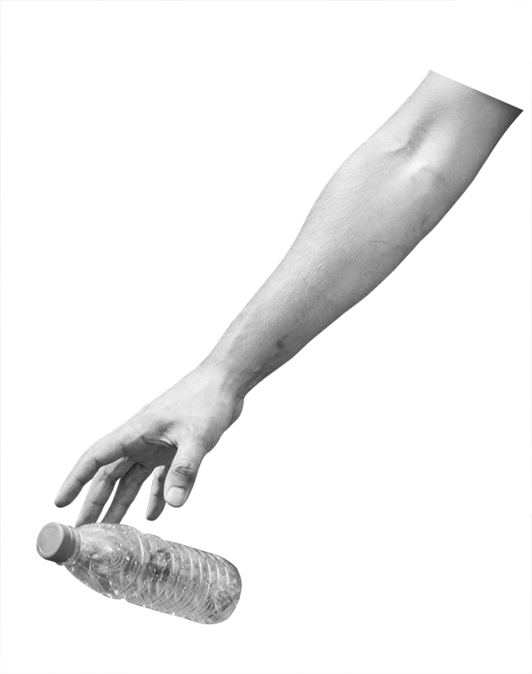
PROBLEM STATEMENT
Scattered scrap detection is a significant problem in many countries around the world. It can lead to a number of negative consequences, including environmental degradation, public health issues, and decreased quality of life for residents.
Garbage can accumulate in public spaces, such as streets, parks, and beaches, due to individuals littering or improperly disposing of waste.
In some areas, waste collection systems may be inadequate or inefficient, leading to a build-up of garbage in certain areas.

Slide 3
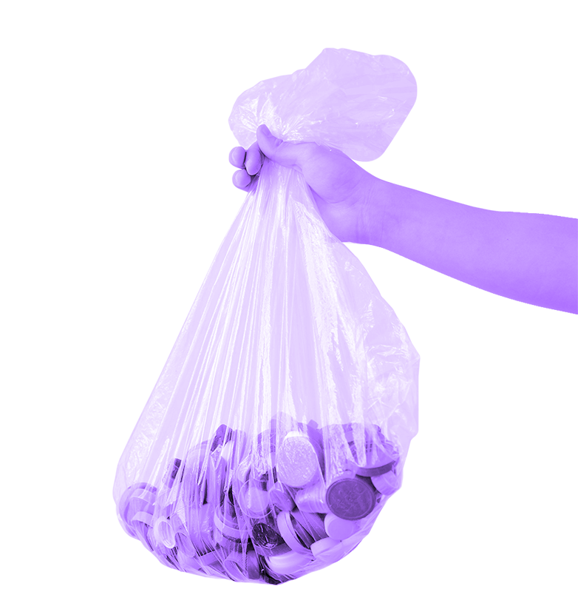
2 billion tonnes
33% of this
3.40 billion tonnes
DATA DRIVES DECISION MAKING!
of municipal waste generated annually.
not disposed in an environmentally safe manner
By 2050- more than double population growth by 2050.

Slide 4
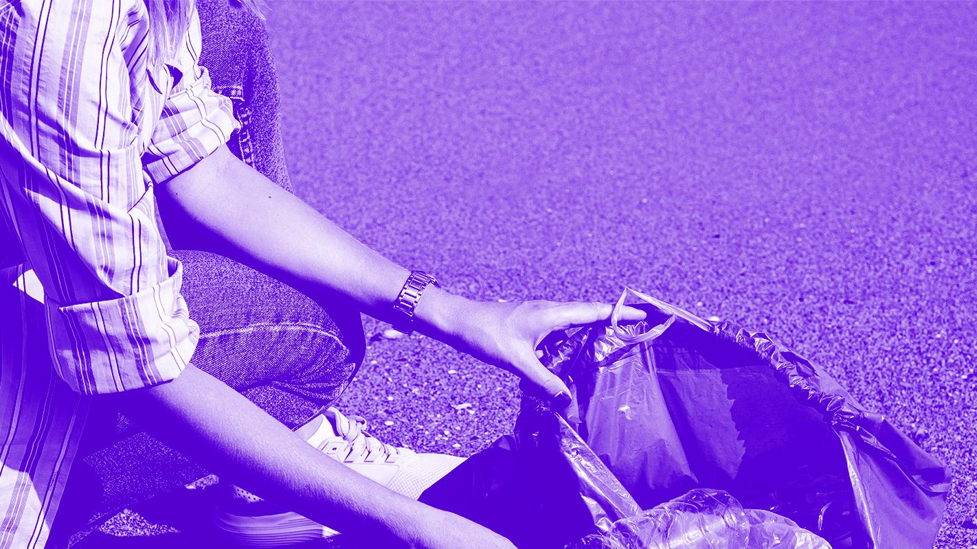

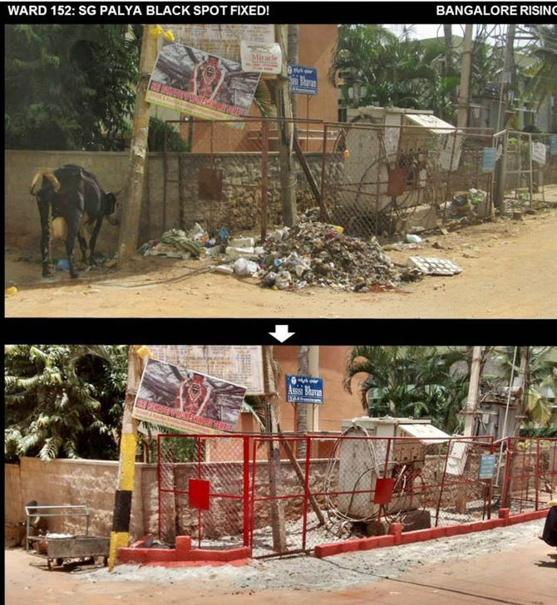
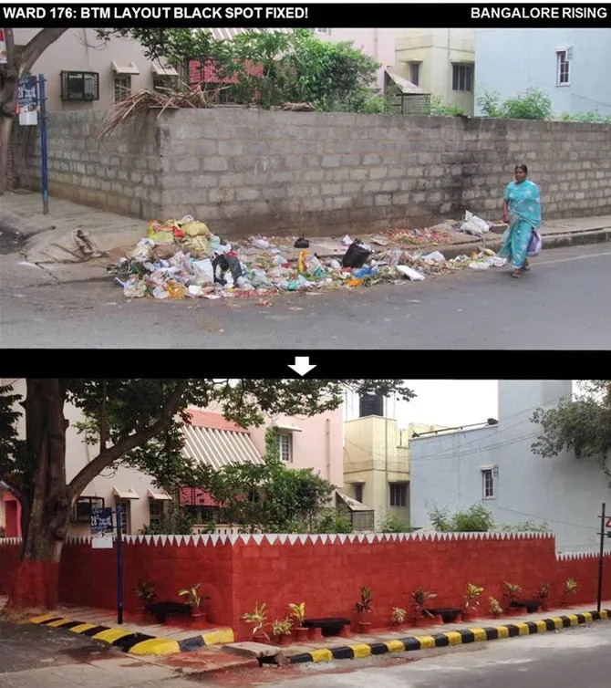
THE NEED

Slide 5
SOLUTION STRATEGY & OBJECTIVES
The goal is design an object detection model which segregates garbage and scattered scrap from the given input data from various sources like dashcams, CCTVs installed in roads etc.
The video is processed and the density of garbage is then calculated and the processed through a machine learning algorithm.
If garbage is detected then the concerned authorities are intimated with help of an escalation algorithm.

Slide 6
TECH STACK
APIs
Twilio
Single Shot Detector
Trained on TACO dataset
Streamlit
OpenCV, TensorFlow, yagmail, Geocoder
Front-end and Visualization
Python Libraries

Slide 7
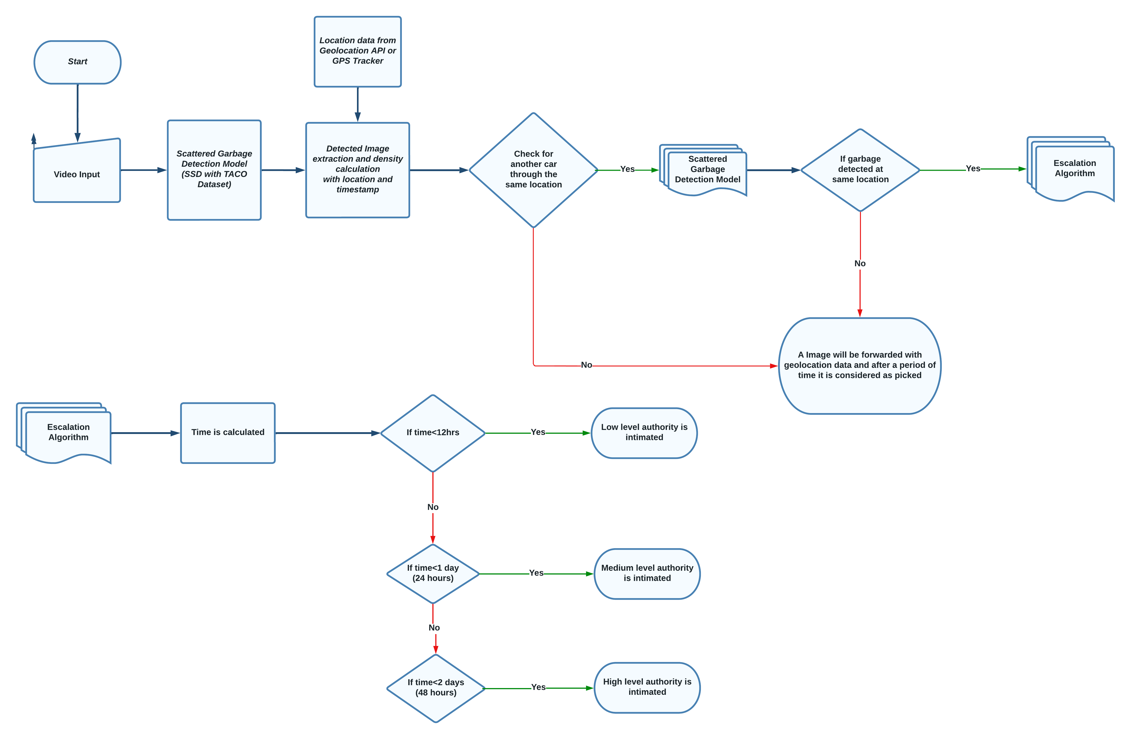
SYSTEM WORKFLOW

Slide 8
ASSUMPTIONS
Most of the cars travelling in Bengaluru are assumed to have dashcams installed on them.
The cameras are assumed to be of 1080P resolution, real time GPS tracking and connected to the internet.
The videos captured are to be connected to the cloud servers in real time where this machine learning algorithm will be running.
COST
The solution implemented is cost efficient and works on the infrastructure which is already present.
Optional resources for better efficiency:
Cameras can be installed on pubic transport which helps the algorithm obtain more data.

Slide 9
FUTURE SCOPE
Traffic violation detection like helmet violations can be solved through the videos obtained through dashcams of cars.
A job tracking system can be implemented in order to verify the jobs done by the garbage collection personnel.
The recyclable items in the scrap can be intimated to the organizations working on recycling of waste/garbage.
A reward system can be used to award the users who provide the real time data for the model.

